Slide 1
ENHANCER
Project
SME Support Grant Scheme for Job Creation

Slide 2
Important note
This presentation include Turkish translations of the Grant Application Guidelines and its annexes, and has been prepared for information purposes for potential grant beneficiaries.
In case of any conflict between this presentation and the grant guidelines and its annexes, the English Grant Applicant Guidelines and its Annexes will be binding.

Slide 3
Objectives of the Programme
The overall objective of this call for proposals is to increase the job creation efforts of relevant local stakeholders in İstanbul, İzmir, Bursa, Konya, Mersin and Kayseri through grant interventions.
The specific objective of this call for proposal is to contribute to well established, financially stable small and medium sized enterprises (SMEs) in the targeted provinces to grow and thereby generate sustainable employment for SuTPs and LHC members.

Slide 4
Priority Areas
The priority areas of this call for proposals are;
Generating sustainable employment for SuTPs and LHC members,
Integrating SuTPs into the Turkish economy through sustainable employment,
Increasing the amount of decent and registered employment opportunities,
Improving matching between jobs and workers in terms of skill
Important Note: The proposed action (project) should cover at least two priority areas under this call for proposals.

Slide 5
Size of Grants
Indicative amount made available under this call for proposals:
3.000.000 Euro
Size of grants:
Minimum: 20.000 Euro
Maximum amount: 55.000 Euro
Percentages of total eligible costs of the action:
Minimum percentage: 75% of the total eligible costs of the action
Maximum percentage: 90% of the total eligible costs of the action
The balance (i.e. the difference between the total cost of the action and the amount requested from the contracting authority) must be financed from sources other than ICMPD and the European Union.

Slide 6
Priorities of the Programme
The main target groups of this Call for Proposals are SMEs that meet the following criteria:
- employ less than 250 persons and
-with annual turnover of no more than EUR 50 million or
-with a total annual balance sheet (total assets) of no more than EUR 43 million
Gender equality should be taken into account when creating the target groups of the proposal.
Final Beneficiaries: Syrians under Temporary Protection and Local Host Communities who will benefit from new employment opportunities that will emerge within SMEs
Duration: Minimum 8, Maximum 12 Months
Location: Bursa, İstanbul, İzmir, Kayseri, Konya and Mersin Provinces

Slide 7
Eligibility Criteria
1
2
3
Applicants:
The ‘lead applicant’, i.e. the entity submitting the application for,
And, if any, its co-applicant(s)
Actions:
Actions for which a grant may be awarded
Costs:
Types of cost that may be incurred in the implementation of an action

Slide 8
Eligibility of Applicants – Lead Applicant
be a legal person (be properly registered) and have their headquarters and operational production facilities in the targeted provinces: İstanbul, İzmir, Bursa, Konya, Mersin and Kayseri; and
be a Small and Medium Sized Enterprise (SME); and
For this call for proposals, the EU SME definition is applied to determine the status of an applicant. Applicants shall calculate the Exchange rate as €1 = TRY 10.44 according to Inforeuro for June 2021. The main factors determining whether an enterprise is an SME are as follows:
have 100% privately owned share; and
have no previous non-paid overdue liabilities, overdue social charges and tax payment, defaulted loans; and
Company Category | Staff Headcount | Annual Turnover | Or |  | Annual Balance Sheet Total (Total Assests)
KOBİ | < 250 | ≤ € 50 m |  | ≤ € 43 m

Slide 9
Eligibility of Applicants – Lead Applicant
be experienced and able to provide information on their capacity to manage projects, corresponding with the size of the project for which a grant is requested; and
be directly responsible for the preparation and management of the action, not acting as an intermediary; and
have been established at least 2 years prior to the announcement date of this call for proposals; and
have net profit at the end of 2019 and 2020; and
not decrease its turnover (in TRY) more than 25% in 2020 compared to 2019
Enterprises that employ fewer than 10 persons are not eligible applicants for this call for proposals.
Enterprises whose annual turnover is below TRY 3 million (based on the income statement for the most recent financial year, which the accounts have been closed) are not eligible applicants for this call for proposals.
Enterprises whose annual balance sheet total (total assets) is below TRY 3 million (based on the balance sheet for the most recent financial year, which the accounts have been closed) are not eligible applicants for this call for proposals.

Slide 10
Eligibility of Applicants – Co-Applicants
Co-applicants participate in designing and implementing the action, and the costs they incur are eligible in the same way as those incurred by the lead applicant.
Co-applicants must satisfy the eligibility criteria as applicable to the lead applicant itself. Co-applicants do not necessarily need to be registered in the same province as the lead applicant; however, they should be registered in one of the targeted provinces: Istanbul, Izmir, Bursa, Konya, Mersin and Kayseri.
Co-applicants must sign the mandate in Section 9 of the grant application form.
If awarded a grant, the co-applicant(s) (if any) will become beneficiary(ies) in the action (together with the lead applicant).

Slide 11
Eligibility of Applicants
Applicants included in the lists of EU restrictive measures at the moment of the award decision cannot be awarded the contract:
a) bankruptcy, insolvency or winding-up procedures;
b) breach of obligations relating to the payment of taxes or social security contributions;
c) grave professional misconduct, including misrepresentation;
d) fraud;
e) corruption;
f) conduct related to a criminal organisation;
g) money laundering or terrorist financing;
h) terrorist offences or offences linked to terrorist activities;
i) child labour and other trafficking in human beings.

Slide 12
Eligibility of Applicants
Caution!
Political parties and their affiliated structures are not eligible as lead applicants or co-applicants under this call for proposals.
Provincial/regional/district directorates of central government cannot participate in this call for proposals as lead applicants or co-applicants; however, they may participate as associates.

Slide 13
Eligible Actions – Type of Actions
As a capacity building project, investments related to R&D, innovation, technology transfer, and IT technology; investments necessary to obtain quality certification under international technical and quality standards;
Consultancy services received for digitalization, internationalization and branding;
Investments for new production units as well as expanding and modernising production capacity in line with creation of employment;
As a capacity building project, professional advice and consultancy services on:
export competitiveness,
improving marketing practices to increase market share and access to new markets such as marketing and market development,
product design and development,
new technologies,
access to finance,
human resources development and on the job training;

Slide 14
Eligible Actions – Type of Actions
Development of mentoring mechanisms and integration in mentoring networks;
Support of design/idea/content/product development activities;
As a capacity building project, procurement of machinery and equipment; software, hardware and licences (but no project may be limited only to the procurement of goods. Procurement of goods must be part of wider action with defined objectives); transport of equipment purchased;
Capacity building and training programs on specialised topics such as commercialization, finance, legal advice, accounting, business development/improvement, export and intellectual property;
Vocational training and apprenticeship programmes accredited by the Turkish Authority as an answer to the needs of SMEs;
In-service training programs including capacity building activities for SMEs;
Establishment of a foreign trade department;
With the support of Arabic language skills of SuTPs, activities that enhance competitiveness of the company through increasing its market share, number of customers and exports, especially in the MENA region.

Slide 15
Eligible Actions – Type of Actions
All actions shall have a positive contribution to employment and economic development. Priority will be given to activities respecting gender equality and increasing women/youth employment and employment of SuTPs.

Slide 16
Eligible Actions – Examples for Ineligible Actions
Actions concerned only or mainly with individual sponsorships for participation in workshops, seminars, conferences, congresses;
Actions concerned only or mainly with individual scholarships for studies or training courses;
Actions already financed or in a process of being financed from state budget or other EU programmes, or other funds;
Establishing and developing any activity in area where the Turkish legislation does not apply regarding safety at work, environment protection, employment of the workforce;
Actions which are ideologically biased or partisan in nature;
Actions of supporting or linked to political parties;
Infrastructure projects;
Actions with costs incurred outside the contract period;
Procurement or lease of land, buildings or other similar facilities and structures;
Actions that had started before applicants signed the contract for awarding grants

Slide 17
Eligibility of Costs – General Criteria
Costs are incurred during the implementation of the Action
Costs are indicated in the overall budget for the Action
Costs are necessary for the implementation of the Action
Costs are identifiable and verifiable, in particular being recorded in the accounting records of the Beneficiary(ies) and determined according to the applicable accounting standards of the country where the Beneficiary(ies) is established and according to the usual cost accounting practices of the Beneficiary(ies);
Costs comply with the requirements of applicable tax and social legislation
Costs are reasonable, justified and comply with the requirements of sound financial management, in particular regarding economy and efficiency

Slide 18
Eligibility of Costs
Eligible Direct Costs
the cost of Project Staff assigned to the Action, corresponding to actual gross salaries including social security charges and other remuneration-related costs; salaries and costs shall not exceed those normally borne by the Beneficiary(ies), unless it is justified by showing that it is essential to carry out the Action;
the cost of created additional employment (or formalise employment) of SuTPs and LHC members; cost of work permit card and its fee; their actual gross salaries including social security charges and other remuneration-related costs. Please note that the total cost of human resources should not exceed the 50% of the total eligible direct costs;
purchase costs for new (second hand purchase is not eligible) equipment, machinery and supplies specifically for the purpose of the Action, provided that ownership is transferred at the end of the Action when required. Please note that the total costs of equipment and supplies (excluding office supplies) should not exceed the 50% of the total eligible direct costs;
costs of consumables;
training/consultancy costs;
visibility costs;
subcontracting costs;

Slide 19
Eligibility of Costs
Eligible Direct Costs
costs entailed by contracts awarded by the Beneficiary for the purposes of the Action;
costs deriving directly from the requirements of the Contract (dissemination of information, evaluation specific to the Action, expenditure verification costs, translation, reproduction, insurance, etc.) including financial service costs (in particular the cost of transfers and financial guarantees where required according to the Contract);
duties, taxes and charges, including VAT, paid and not recoverable by the Beneficiary, unless otherwise provided in the Special Conditions;
Pre-financing guarantee cost.

Slide 20
Eligiblity of Costs
Contingency Reserve
Indirect Costs
The budget should not include a contingency reserve, as it is not eligible as a cost under this call for proposals.
The indirect costs incurred in carrying out the action may be eligible for flat rate funding, but the total must not exceed 2% of the estimated total eligible direct costs. Indirect costs are eligible provided that they do not include costs assigned to another budget heading in the standard grant contract. The lead applicant may be asked to justify the percentage requested before the grant contract is signed. Once the flat rate has been fixed in the special conditions of the grant contract, no supporting documents need to be provided.

Slide 21
Eligibility of Costs – Ineligible Costs
Construction and refurbishment costs except for the small renovations for installation of the necessary equipment/machinery;
Travel and subsistence cost for staff and other persons taking part in the Action;
Office vehicle costs and office rent;
Debts and debt service charges (interest);
Provisions for losses or potential future liabilities;
Costs declared by the beneficiary and financed by another action or work programme receiving an ICMPD or European Union (including through EDF) grant;
Purchases of land or buildings,
Currency exchange losses;
Contributions in-kind;
Credits to third parties;
Non-project related expenditures;
Amortisation and depreciation costs;
Fines, financial penalties and court costs
No-Profit Principle
The grant may not produce a profit for the applicant(s) or co-applicant(s). Profit is defined as a surplus of the receipts over the eligible costs approved by the Contracting Authority when the request for payment of the balance is made.

Slide 22
Ethics Clauses and Code of Conduct
Absence of conflict of interest
Respect for human rights as well as environmental legislation and core labour standards
Anti-corruption and anti-bribery
Unusual commercial expenses
Breach of obligations, irregularities or fraud
Zero tolerance for sexual exploitation, abuse and harassment
The ICMPD applies a policy of 'zero tolerance' in relation to all wrongful conduct which has an impact on the professional credibility of the applicant.
Physical abuse or punishment, or threats of physical abuse, sexual abuse or exploitation, harassment and verbal abuse, as well as other forms of intimidation shall be prohibited

Slide 23
How to Apply?
Applications (application form, other annexes and supporting documents) must be submitted on the ICMPD electronic Application Platform
Please note that documents provided to the IN-TEND system should be in the following formats:
Application form must be submitted as a WORD file AND as a signed scanned version (PDF)
Budget must be submitted as an EXCEL file AND as a signed scanned version (PDF)
Logframe must be submitted as a WORD file AND as a signed scanned version (PDF)
All supporting documents must be scanned and in PDF format

Slide 24
Documents to be filled
Annex A: Application Form
Annex B: Budget
Annex C: Logical Framework
Annex D: Legal Entity Identification Form
Annex E: Financial Identification Form
Annex F: Supporting Documents Mentioned in Section 2.3.2
(Two separate placeholders are reserved for Annex A & Annex B and Annex C documents in the electronic application platform, one for uploading the scanned PDF version and the other for uploading the electronic version.)

Slide 25
Supporting Documents-ANNEX F Please see the Guideline ( Section 2.3.2) for further details
Copies of the Turkish Trade Registry Gazette of the Lead Applicant and, if any, of each co-applicant
Audit report (That report shall include and certify the accounts for the last 2 financial years available)
SME Status Declaration Form
Copy of Chamber Registration
Board decision of the lead applicant’s
List of Authorised Signatories
A copy of tax registration or a document of the lead applicant indicating the tax number from the relevant tax authority
Up-to-date evidence on the fulfilment (including restructuring etc.) of obligations related to social security contributions
Up-to-date evidence on the fulfilment (including restructuring etc.) of the fiscal/tax obligations
The quality certificates and the proof for patent rights
Authorization, licenses or necessary permits from the relevant authorities
Active workers list approved by Social Security Institution (SGK)
Title deed or the documentation (rental agreement) proving the right of usufruct of the building/facility/premise of the company where project activities will be implemented
Declarations/mandates/statements/certificate obtained from the authorized execution offices of the lead applicant and co-applicant that there are no finalized seizure transactions of 3% or more of ICMPD’s financial support - for the lead applicant and each co-applicant (if any).
If there are linked and/or partner enterprises of lead applicant and co-applicant(s) (if any), please provide following information of linked and/or partner companies: active workers list approved by Social Security Institution (SGK), current shareholders’ structure (Turkish Trade Registry Gazette), last 2 years’ certified financial statements of linked and/or partner enterprises (YMM, SMMM).

Slide 26
How to Register and Apply on ICMPD Electronic Application Platform (In-TEND)
To access the (In-tend) Call for Proposals Electronic Application Platform, visit:
https://in-tendhost.co.uk/icmpd/aspx/Tenders/Appraisal
Please check “How to Register and Apply Manual” which is available at:
https://in-tendhost.co.uk/icmpd/aspx/BuyerProfiles

Slide 27
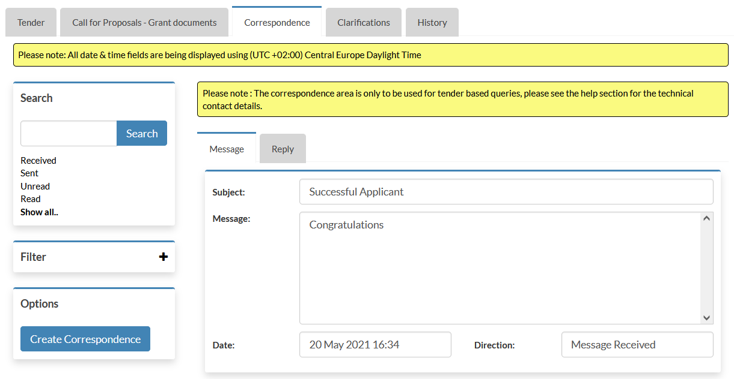
Communication - Asking questions about a Call for Proposals
When ICMPD sends you a correspondence message you will receive an automated email notification. The correspondence message can be accessed from three places (1, 2, 3).
3
1
2
26

Slide 28
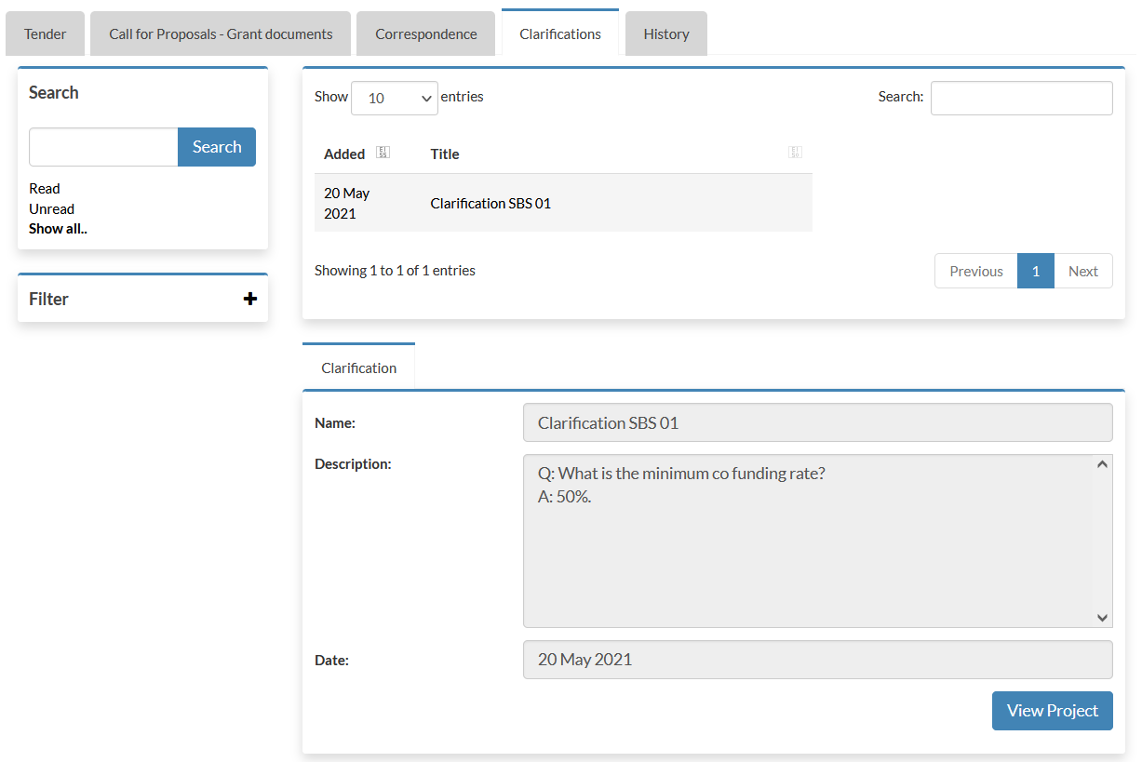
Communications - Clarifications issued by ICMPD
Clarifications may be published by ICMPD to inform all potential applicants of any material changes, missing information, or responses to clarifications questions that may have been received regarding the Call for Proposals.
If a clarification has been published then you will be notified via email and can access the new information under the Clarification (1) tab within the Call for Proposals management area of the project.
(1) The clarifications tab will give access to all clarifications issued for this Call for Proposals. Select the required clarification to view the information. A paper clip icon indicates a file attachment which can be accessed through the ‘Attachments Tab’.
Note: The clarification area of the portal is a one way messaging tool for ICMPD. Any questions relating to the content of a clarification should be made using the correspondence function.
1
27

Slide 29
Reminder
The deadline for the submission of applications is 13 September 2021, 17:00h (Vienna local time).
Any application submitted after the deadline will automatically be rejected.
The lead applicant is strongly advised not to wait until the last day to submit its application, since heavy Internet traffic or a fault with the Internet connection (including electricity failure, etc.) could lead to difficulties in submission
IMPORTANT!
Any application submitted after the deadline will automatically be rejected.

Slide 30
Indicative Timetable
 | DATE | TIME (Vienna local time)
1. Deadline for registering to the information session (online webinar) | 12 July 2021 | 11:00
2. Information meeting (online webinar) | 12 July 2021 | 13:30
3. Information meeting | August 2021 (Exact date TBD) | (Exact time TBD)
4. Deadline for requesting any clarifications from the contracting authority | 23 August 2021 | 17:00
5. Last date on which clarifications are issued by the contracting authority | 31 August 2021 | 17:00
6. Deadline for submission of applications | 13 September 2021 | 17:00
7. Notification to the applicants on the results of evaluation (predicted time) | January 2022
8. Contract signature (predicted time) | February 2022

Slide 31
Information
www.enhancerprojesi.com
www.enhancerproject.com
ICMPD_Turkey
ICMPD in Turkey
ICMPD in Turkey
ICMPD in Turkey

Slide 32
Contact
grants@icmpd.org

Slide 33
Thank You!

